Slide 1
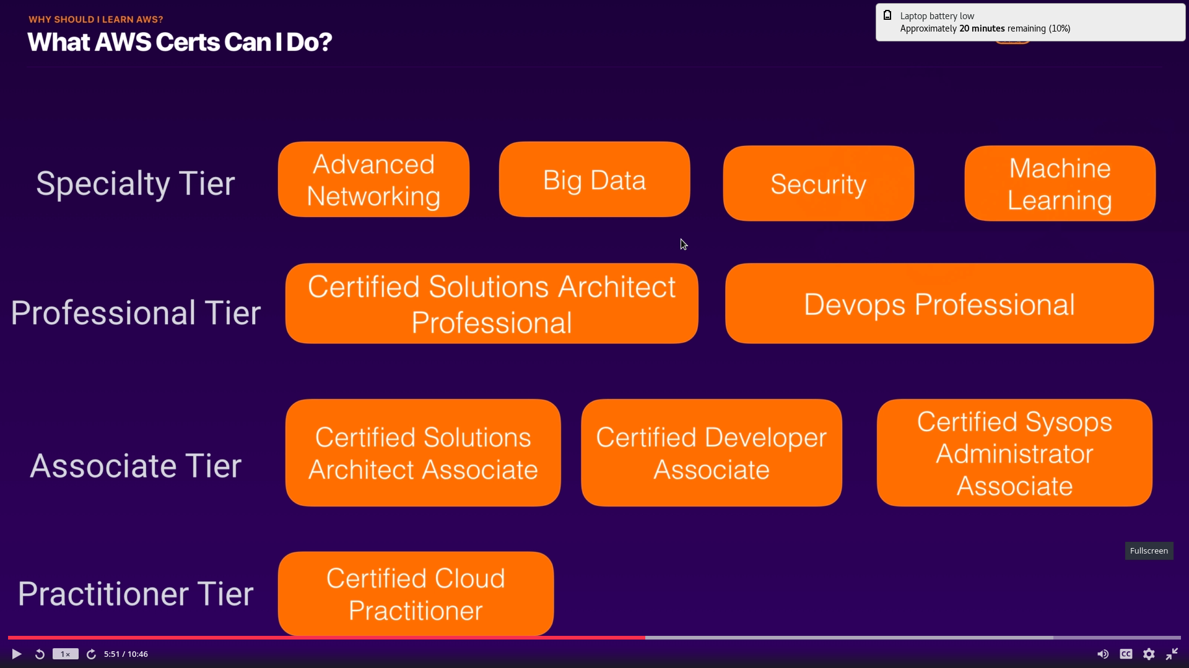
https://www.udemy.com/course/aws-certified-solutions-architect-associate/
White paper
https://d1.awsstatic.com/whitepapers/aws-overview.pdf

Slide 2
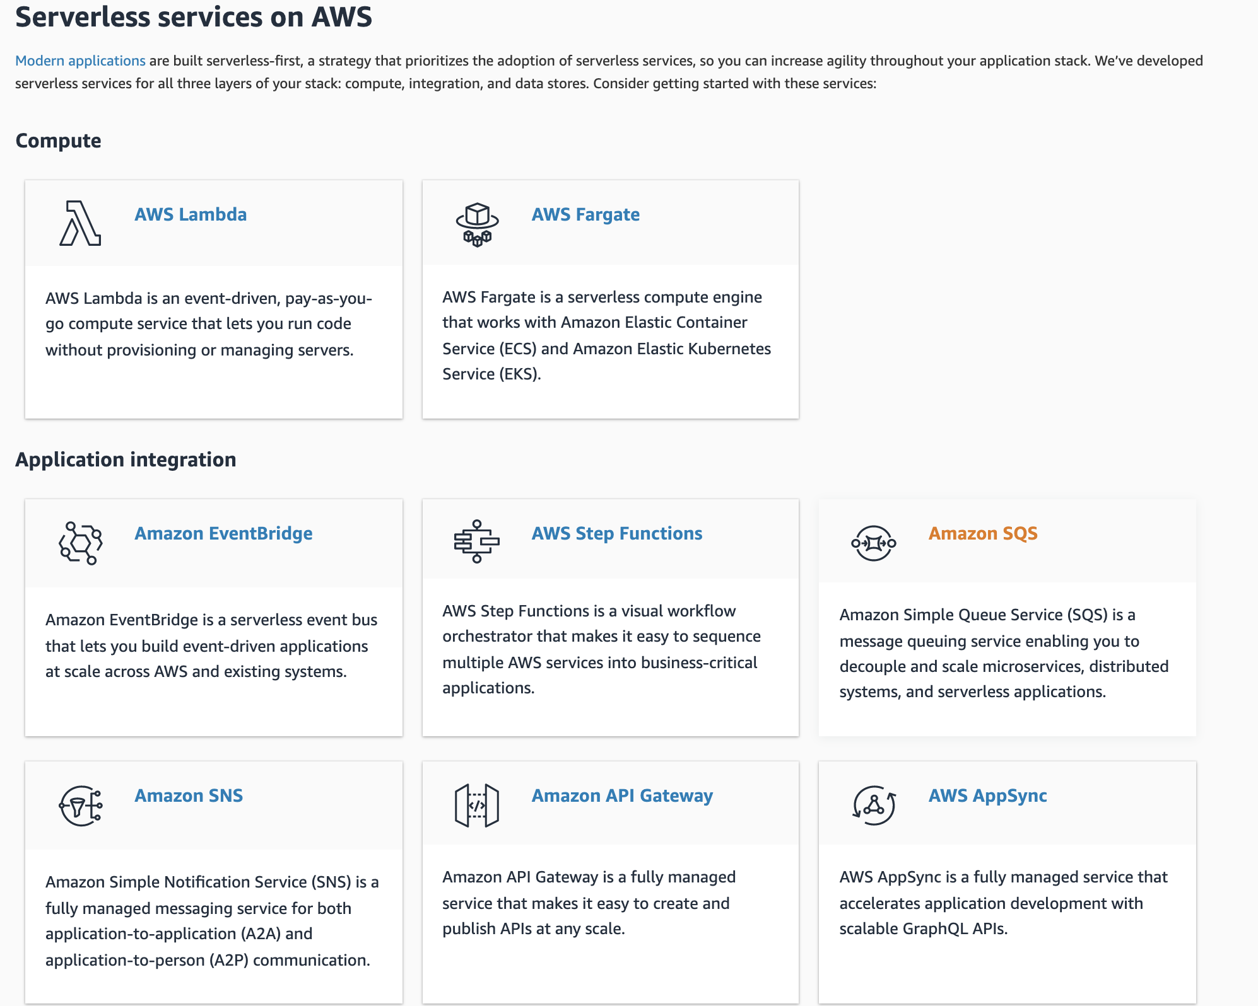

Slide 3
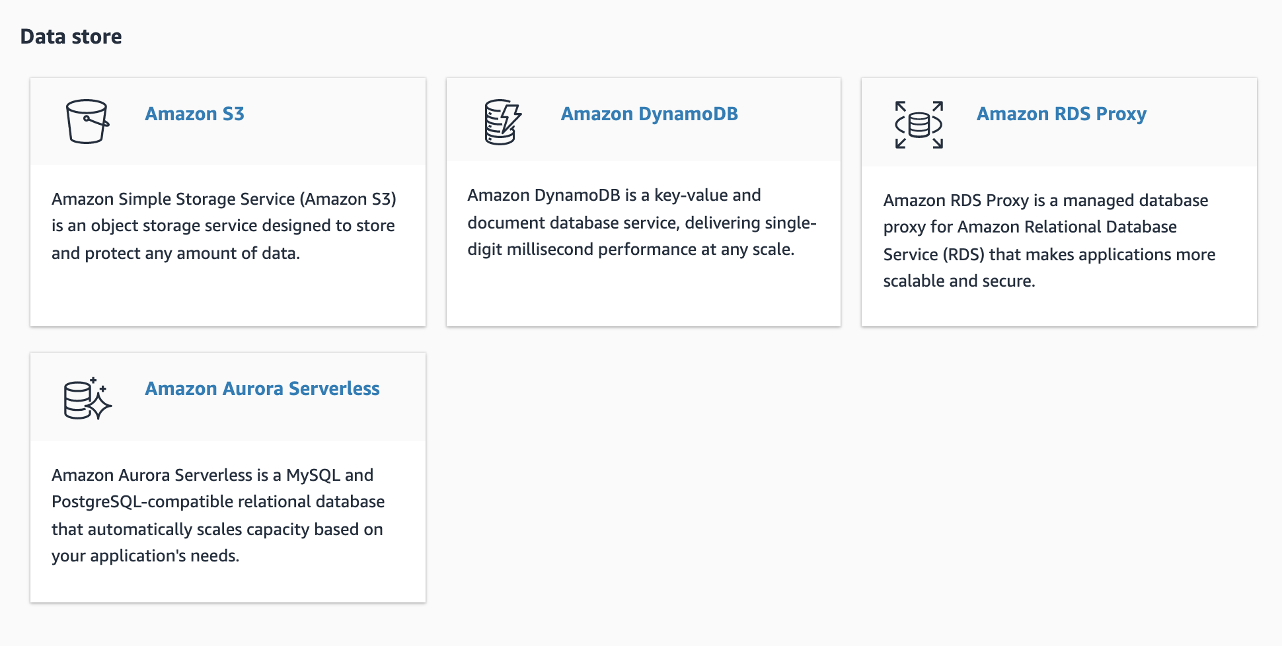

Slide 4
There are three fundamental drivers of cost with AWS:
Compute,
Storage, and
Outbound data transfer.
In most cases, there is no charge for inbound data transfer or data transfer between other AWS services within the same region. Outbound data transfer is aggregated across services and then charged at the outbound data transfer rate.

Slide 5
AWS Compute Optimizer helps you identify the optimal AWS resource configurations, such as
Amazon EC2 instance types,
Amazon EBS volume configurations,
EC2 Auto Scaling groups and
AWS Lambda function memory sizes,
using machine learning to analyze historical utilization metrics.
AWS Shield Advanced provides expanded DDoS attack protection for web applications running on the following resources:
Amazon Elastic Compute Cloud,
Elastic Load Balancing (ELB),
Amazon CloudFront,
Amazon Route 53,
AWS Global Accelerator.
Amazon Elastic File System (Amazon EFS) provides a simple, scalable, fully managed elastic NFS file system for use with AWS Cloud services and on-premises resources. It is built to scale on-demand to petabytes without disrupting applications, growing and shrinking automatically as you add and remove files, eliminating the need to provision and manage capacity to accommodate growth.
The service is designed to be highly scalable, highly available, and highly durable. Amazon EFS file systems store data and metadata across multiple Availability Zones in an AWS Region. EFS file system can be mounted on instances across multiple Availability Zones.
Amazon Elastic Block Store (EBS) is an easy to use, high-performance block storage service designed for use with Amazon Elastic Compute Cloud (EC2) for both throughput and transaction-intensive workloads at any scale.
Designed for mission-critical systems, EBS volumes are replicated within an Availability Zone (AZ) and can easily scale to petabytes of data. You can attach an available EBS volume to one instance that is in the same Availability Zone as the volume.

Slide 6
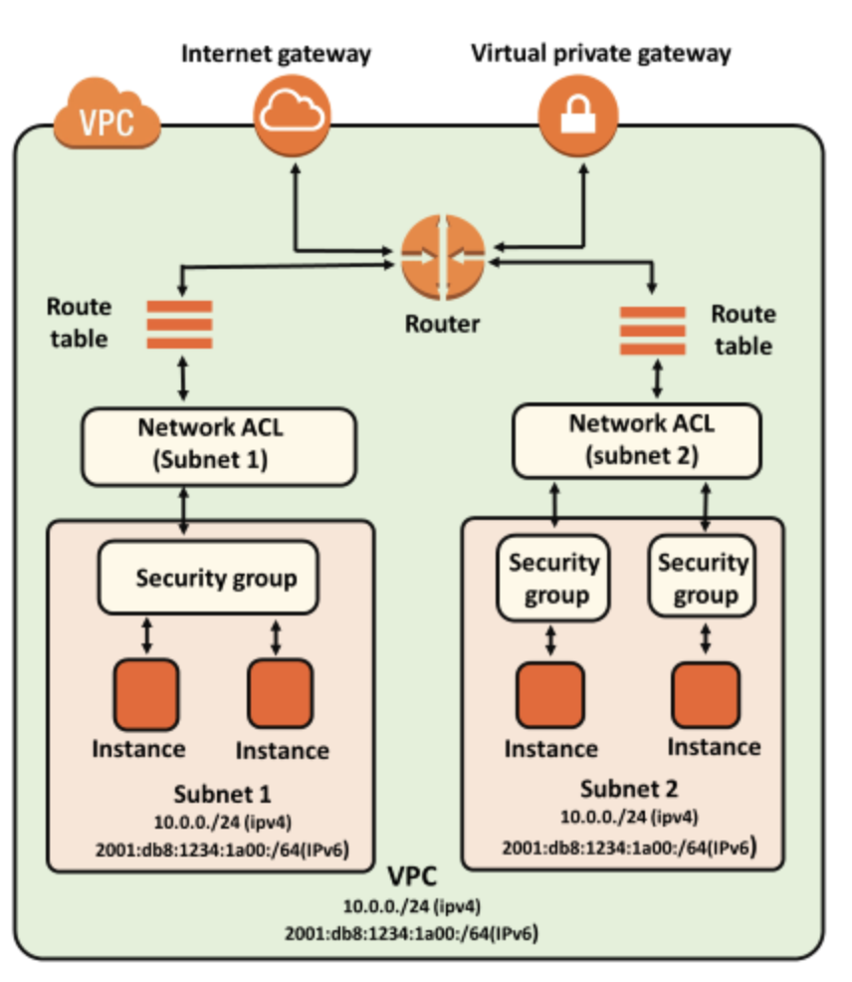
Security Group:
You can specify allow rules, but not deny rules.
When you first create a security group, it has no inbound rules. Therefore, no inbound traffic is allowed until you add inbound rules to the security group.
When you first create a security group, it has an outbound rule that allows all outbound traffic from the resource. You can remove the rule and add outbound rules that allow specific outbound traffic only. If your security group has no outbound rules, no outbound traffic is allowed.

Slide 7
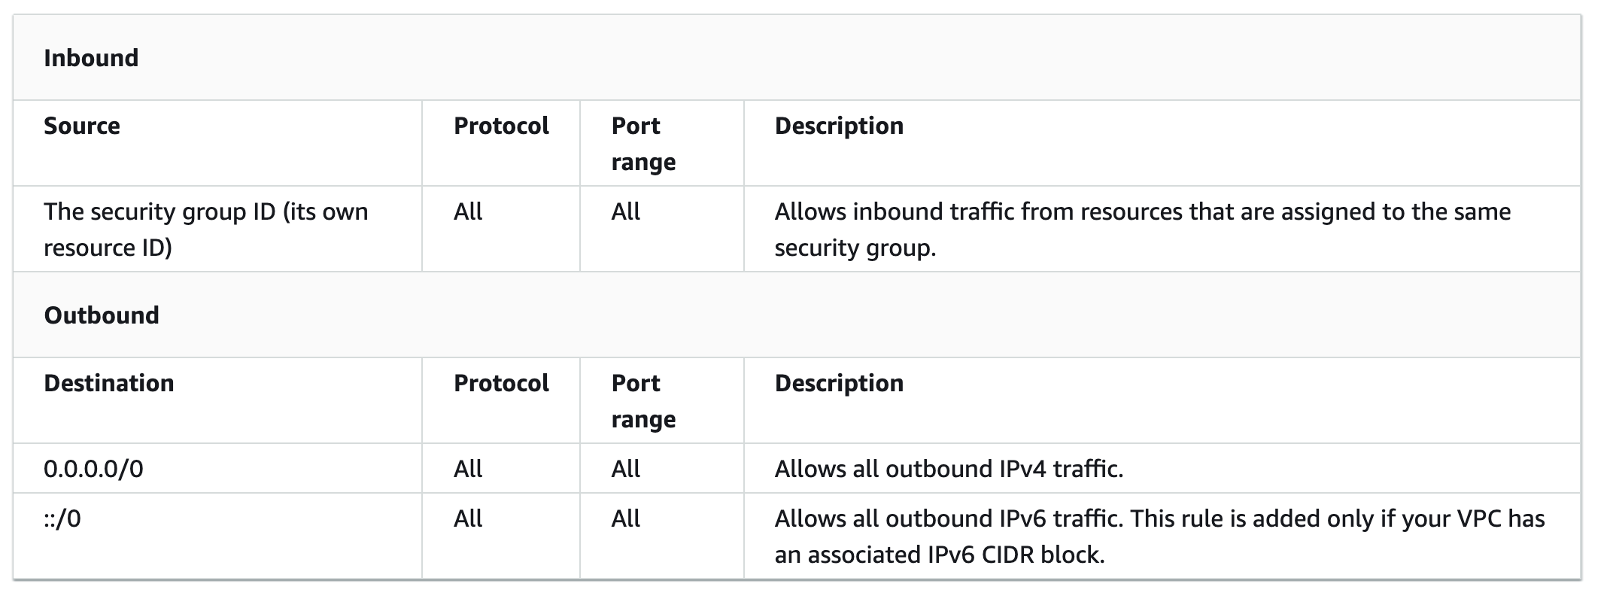
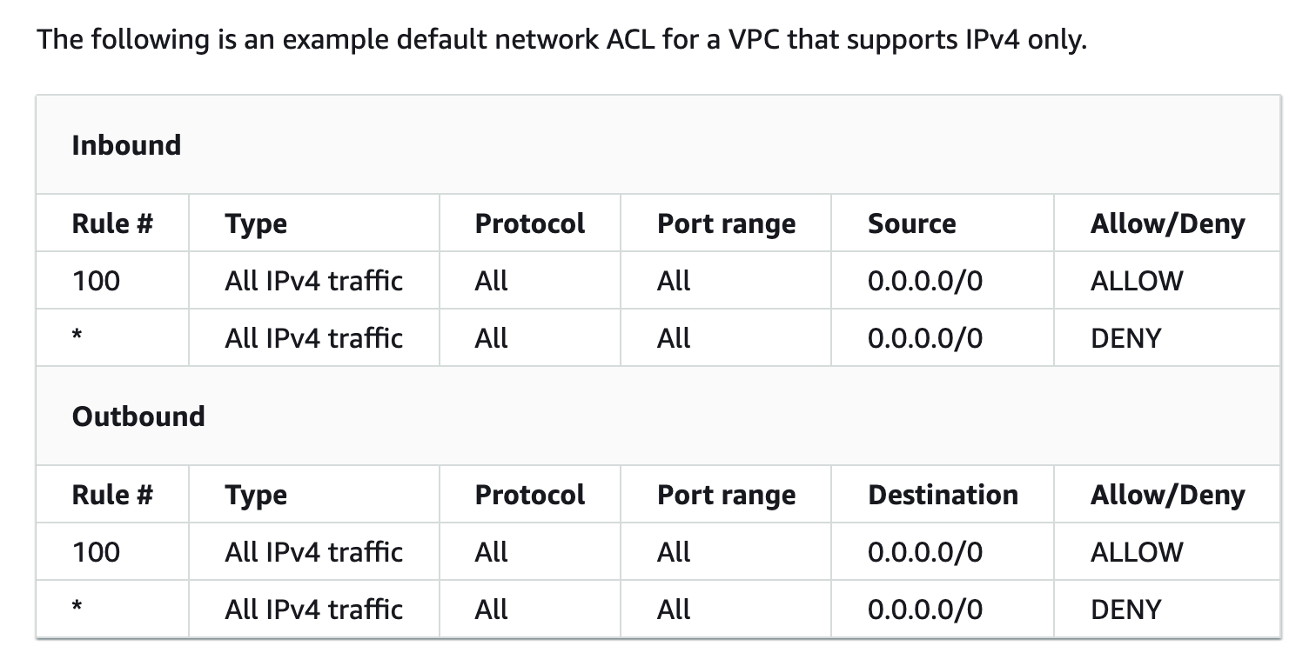
Security Group
1. Firewall to protect EC2 instances
2. These are stateful, which means any changes which are applied to an incoming rule is automatically applied to a rule which is outgoing
Example: If the incoming port of a request is 80, the outgoing response of that request is also 80 (it is opened automatically) by default.
3. It supports only allow rules, and by default, all the rules are denied. You cannot deny the rule for establishing a connection.
4. It is the first layer of defense.
5. you can assign up to five security groups to the instance
NACL
1. Firewall or protection for the subnet.
2.These are stateless, meaning any change applied to an incoming rule isn’t automatically applied to an outgoing rule.
Example: If a request comes through port 80, it should be explicitly indicated that its outgoing response would be the same port 80.
3. It supports both allow and deny rules, and by default, all the rules are denied. You need to add the rule which you can either allow or deny it.
4.It is the second layer of defense.
Your default VPCs and any VPCs that you create come with a default security group. With some resources, if you don't associate a security group when you create the resource, we associate the default security group. For example, if you do not specify a security group when you launch an EC2 instance, we associate the default security group .
You can change the rules for a default security group. You can't delete a default security group. If you try to delete the default security group, you get the following error: Client.CannotDelete.
Default Inbound Allowed for all resources assigned with same security group.
Outbound allowed for all destination.
The default network ACL is configured to allow all traffic to flow in and out of the subnets with which it is associated. Each network ACL also includes a rule whose rule number is an asterisk. This rule ensures that if a packet doesn't match any of the other numbered rules, it's denied. You can't modify or remove this rule.
Rule number:
The rules are evaluated in number order.
As soon as the traffic matches the rule, the Allow/Deny is applied and evaluation ends.

Slide 8
AWS Systems Manager Session Manager
AWS SSM Session Manager is a fully-managed service that provides you with an interactive browser-based shell and CLI experience. It helps provide secure and auditable instance management without the need to open inbound ports, maintain bastion hosts, and manage SSH keys. Session Manager helps to enable compliance with corporate policies that require controlled access to instances, increase security and auditability of access to the instances while providing simplicity and cross-platform instance access to end-users.
Incorrect options:
Amazon EC2 Instance Connect - Amazon EC2 Instance Connect provides a simple and secure way to connect to your Linux instances using Secure Shell (SSH). With EC2 Instance Connect, you use AWS Identity and Access Management (IAM) policies and principals to control SSH access to your instances, removing the need to share and manage SSH keys. Instance Connect will need port 22 to be open for traffic. Therefore, not the correct option here.
Foundations are part of the Reliability pillar of the AWS Well-Architected Framework.
AWS states that before architecting any system, foundational requirements that influence reliability should be in place.
The services that are part of foundations are:
Amazon VPC,
AWS Trusted Advisor,
AWS Service Quotas (formerly called AWS Service Limits).
Service Quotas enables you to view and manage your quotas for AWS services from a central location. Quotas, also referred to as limits in AWS, are the maximum values for the resources, actions, and items in your AWS account. Each AWS service defines its quotas and establishes default values for those quotas.

Slide 9
Amazon MQ - Amazon MQ is a managed message broker service for Apache ActiveMQ and RabbitMQ that makes it easy to set up and operate message brokers on AWS. Amazon MQ reduces your operational responsibilities by managing the provisioning, setup, and maintenance of message brokers for you. Because Amazon MQ connects to your current applications with industry-standard APIs and protocols, you can easily migrate to AWS without having to rewrite code.
If you're using messaging with existing applications, and want to move the messaging functionality to the cloud quickly and easily, AWS recommends you consider Amazon MQ. It supports industry-standard APIs and protocols so you can switch from any standards-based message broker to Amazon MQ without rewriting the messaging code in your applications. If you are building brand new applications in the cloud, AWS recommends you consider Amazon SQS and Amazon SNS.
Pillars - The Well-Architected Framework provides guidance on building secure, high-performing, resilient, and efficient infrastructure for cloud based applications. Based on five pillars — operational excellence, security, reliability, performance efficiency, and cost optimization — the Framework provides a consistent approach for customers and partners to evaluate architectures, and implement designs that will scale over time.
Amazon Redshift - Accelerate your time to insights with fast, easy, and secure cloud data warehousing at scale.
Amazon Redshift uses SQL to analyze structured and semi-structured data across data warehouses, operational databases, and data lakes, using AWS-designed hardware and machine learning to deliver the best price performance at any scale.

Slide 10
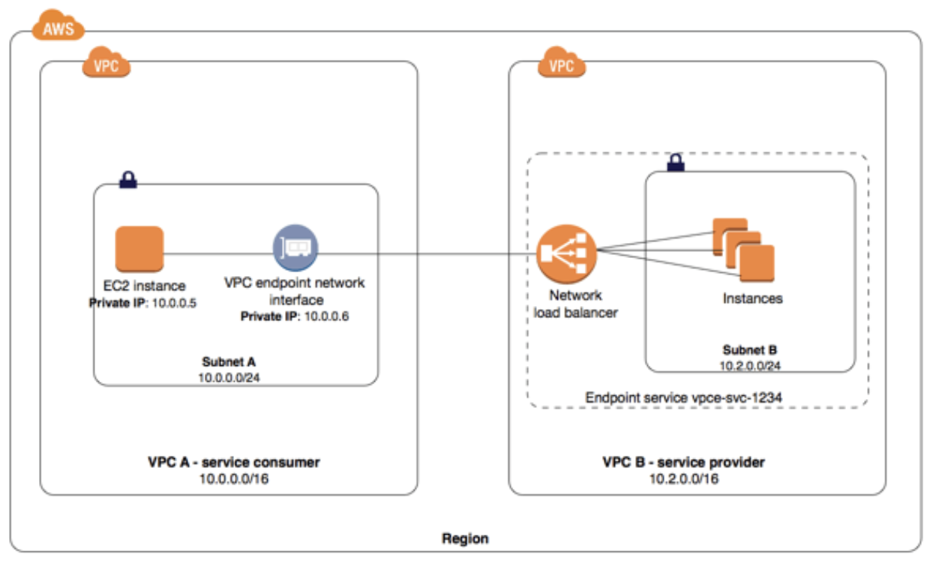
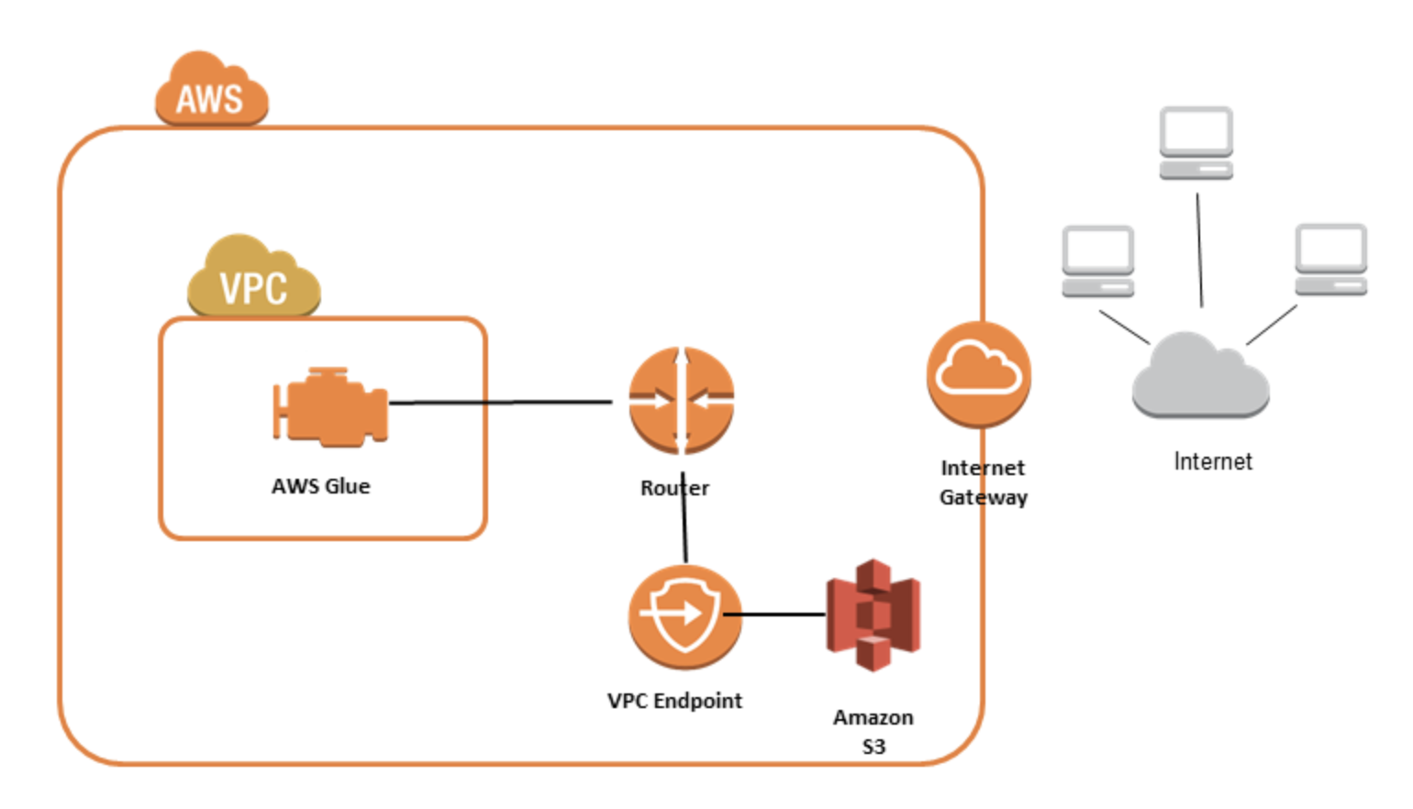
A VPC endpoint enables connections between a virtual private cloud (VPC) and supported services, without requiring that you use an internet gateway, NAT device, VPN connection, or AWS Direct Connect connection. Therefore, you control the specific API endpoints, sites, and services that are reachable from your VPC.
VPC endpoints are virtual devices. They are horizontally scaled, redundant, and highly available VPC components. The following are the different types of VPC endpoints. You create the type of VPC endpoint that's required by the supported service.
Interface endpoints
An interface endpoint is an elastic network interface with a private IP address from the IP address range of your subnet.
An interface endpoint is an elastic network interface that allows a private IP address in a subnet to connect VPC resources to a number of AWS services, such as CloudFormation, Elastic Load Balancers (ELBs), SNS, and more.
Interface endpoints also let VPC resources connect to supported AWS Marketplace partner services in addition to endpoint services, which are hosted by AWS customers or partners in their own VPCs.
Gateway endpoints
A gateway endpoint is a gateway that is a target for a route in your route table used for traffic destined to either Amazon S3 or DynamoDB.

Slide 11
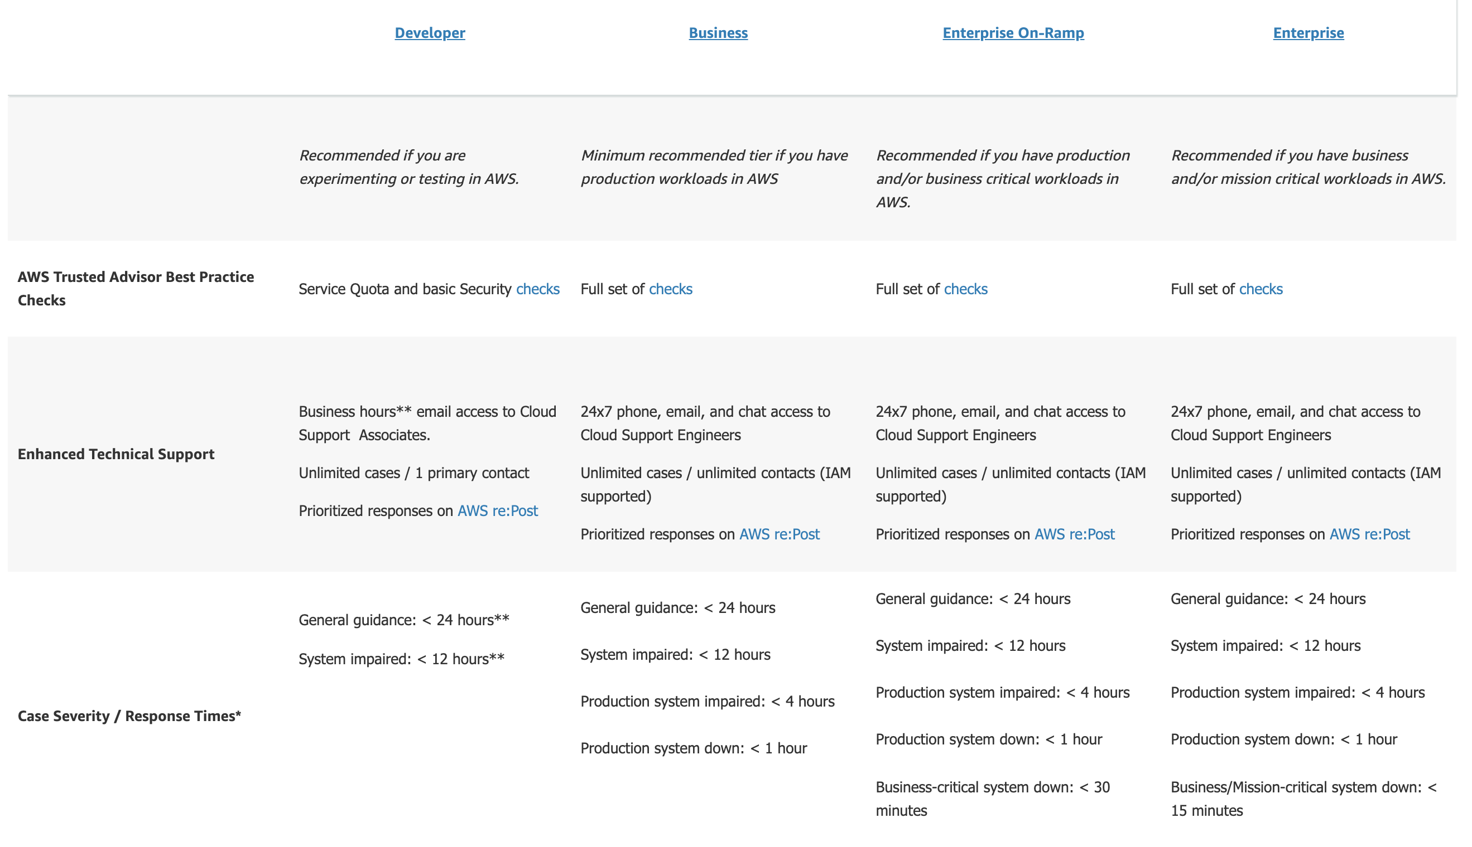
AWS support plan
Basic Support is included for all AWS customers and includes:
Customer Service and Communities - 24x7 access to customer service, documentation, whitepapers, and AWS re:Post.
AWS Trusted Advisor - Access to core Trusted Advisor checks and guidance to provision your resources following best practices to increase performance and improve security.
AWS Personal Health Dashboard - A personalized view of the health of AWS services, and alerts when your resources are impacted.

Slide 12
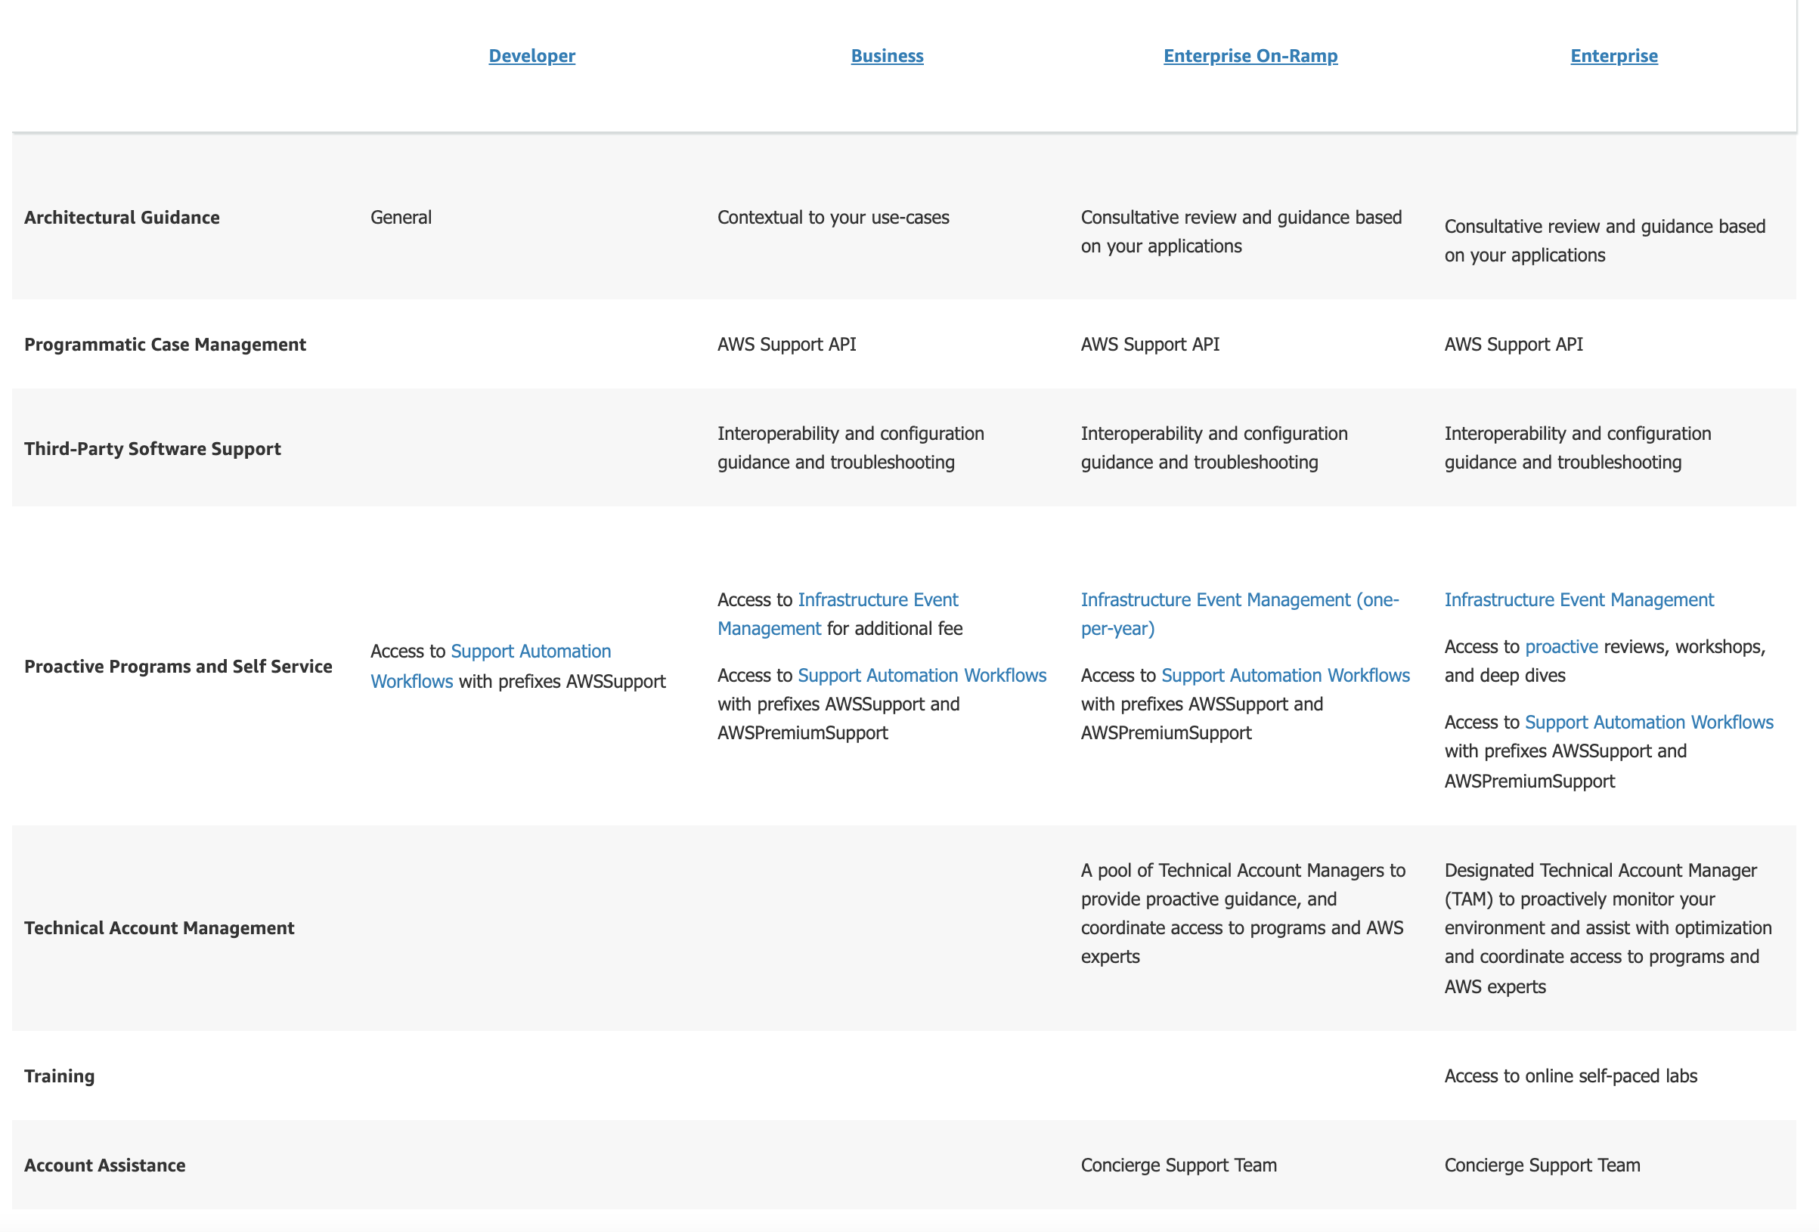
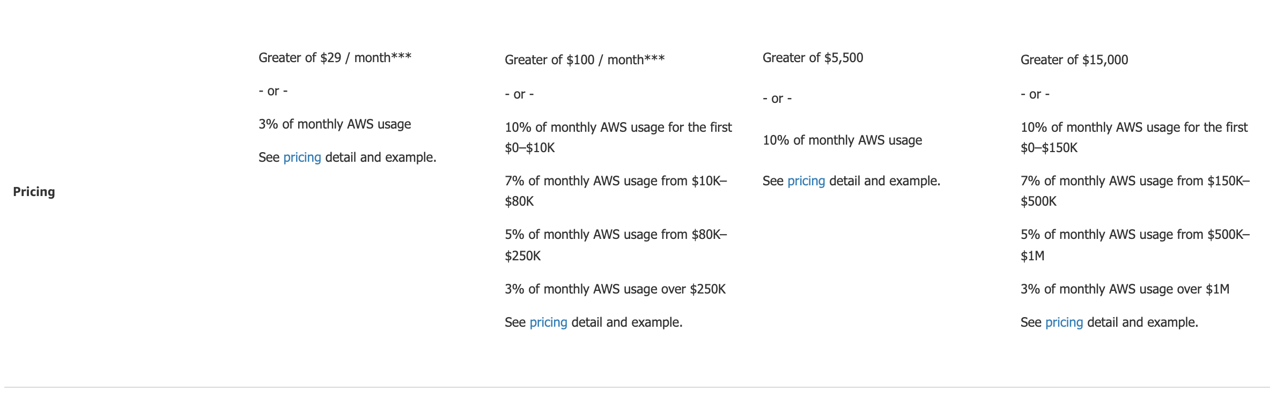

Slide 13
AWS Developer Support
If you are testing or doing early development on AWS and want the ability to get technical support during business hours as well as general architectural guidance as you build and test.
In addition to enhanced technical support and architectural guidance, Developer Support provides access to documentation and forums, AWS Trusted Advisor, and AWS Personal Health Dashboard.
Architectural support
General guidance on how to use AWS products, features, and services together. AWS Solutions Architects leverage the AWS Well-Architected framework when providing recommendations.
Enhanced technical support
Business hours email access to Cloud Support engineers. You can have one primary contact that can open an unlimited amount of cases. Response times for general guidance is less than 24 business hours* and system impaired is less than 12 business hours*.
AWS Trusted Advisor
AWS Trusted Advisor provides you real time guidance to help you provision your resources following AWS best practices. Trusted Advisor checks help optimize your AWS infrastructure, increase security and performance, reduce your overall costs, and monitor service limits. Seven core checks are included with Developer Support.
AWS Personal Health Dashboard
AWS Personal Health Dashboard provides a personalized view of the health of AWS services, and alerts when your resources are impacted. Also includes the AWS Health API for integration with your existing management systems.
AWS Support Automation Workflows
AWS Support Automation Workflows enable you to diagnose and resolve common Support issues following AWS best practices. Access to Support Automation Workflows with prefix AWSSupport is included with Developer Support.
Customer service and communities
24x7 access to customer service, documentation, whitepapers, and support forums.

Slide 14
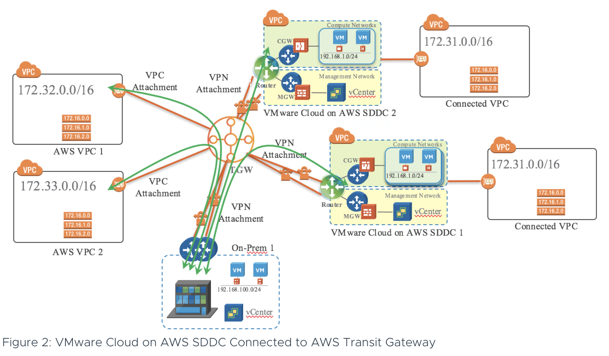
AWS Transit Gateway
AWS Transit Gateway connects VPCs and on-premises networks through a central hub. This simplifies your network and puts an end to complex peering relationships.
https://blogs.vmware.com/networkvirtualization/2020/06/vmware-cloud-on-aws-with-transit-gateway-demo.html/

Slide 15
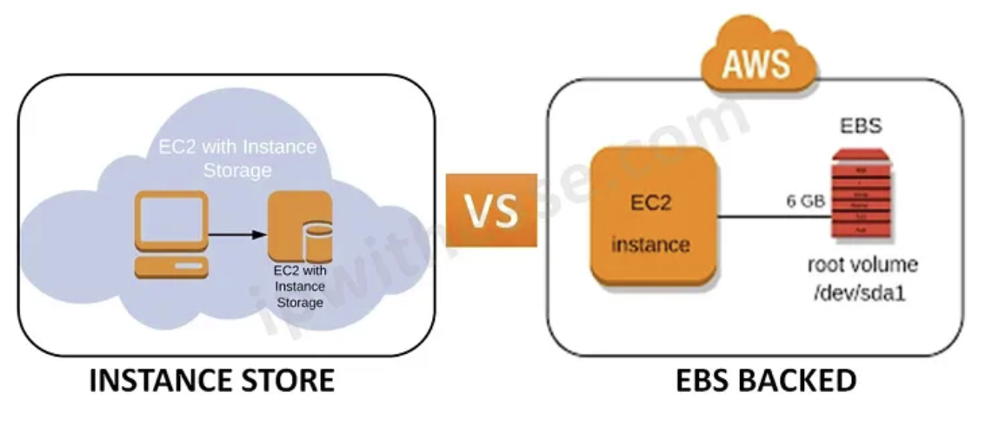
Difference B/W AWS EBS And Instance Store
EBS volume is a persistent block storage volume. The word ‘persistent’ here simply means if you reboot your instance the data will be there. It is like a virtual hard disk on the cloud.
Amazon EBS volume behaves like a raw, unformatted, and external block device that can be attached to a single EC2 instance at a time. Amazon EBS provides highly available, reliable, durable, block-level storage volumes that can be attached to a running instance. But not directly attached to an instance host computer it is more of network-attached storage.
Snapshots- Amazon EBS provides an additional advantage that EBS volumes can be backed by creating a snapshot of a volume that is stored in Amazon S3. So whenever you want to retrieve your data, you can create a volume from that snapshot. This feature is not present with the instance store.
Amazon EBS volume snapshots can be copied to another region and restored to new volumes that make it easier to leverage multiple AWS regions for disaster recovery.
Instance store instance provides ephemeral block-level storage. This storage is best suited for information that changes frequently like buffer, caches, etc.
An instance store provides temporary block-level storage to your instance. It is located on disks that are physically attached to the host computer.
Data is persistent until it is associated with an instance. If an instance is stopped or terminated, any data on instance store volumes is lost.
Stopped State– In the case of instance store, if the host device that provided the ec2 instance fails due to internal errors. All the data on the Ec2 instance store is lost.
Volumes– In the instance store, the volume can only be specified to an instance during its launch. Later we can not add a new storage volume to that ec2.
Verdict-
When we talk about storage in terms of EC2 instances then two things come to our mind- one is EBS volume, and the other is instance store. Both have their benefits. If we talk about Instance stores, it has massive IOPS at low latency, and we talk about creating a snapshot from volume then EBS volume comes in handy. So, decide the level of acceptable Risk and ‘Design for Failure’ accordingly, regardless of the technology.
https://blog.opstree.com/2021/11/30/ec2-store-overview-difference-b-w-aws-ebs-and-instance-store/

Slide 16
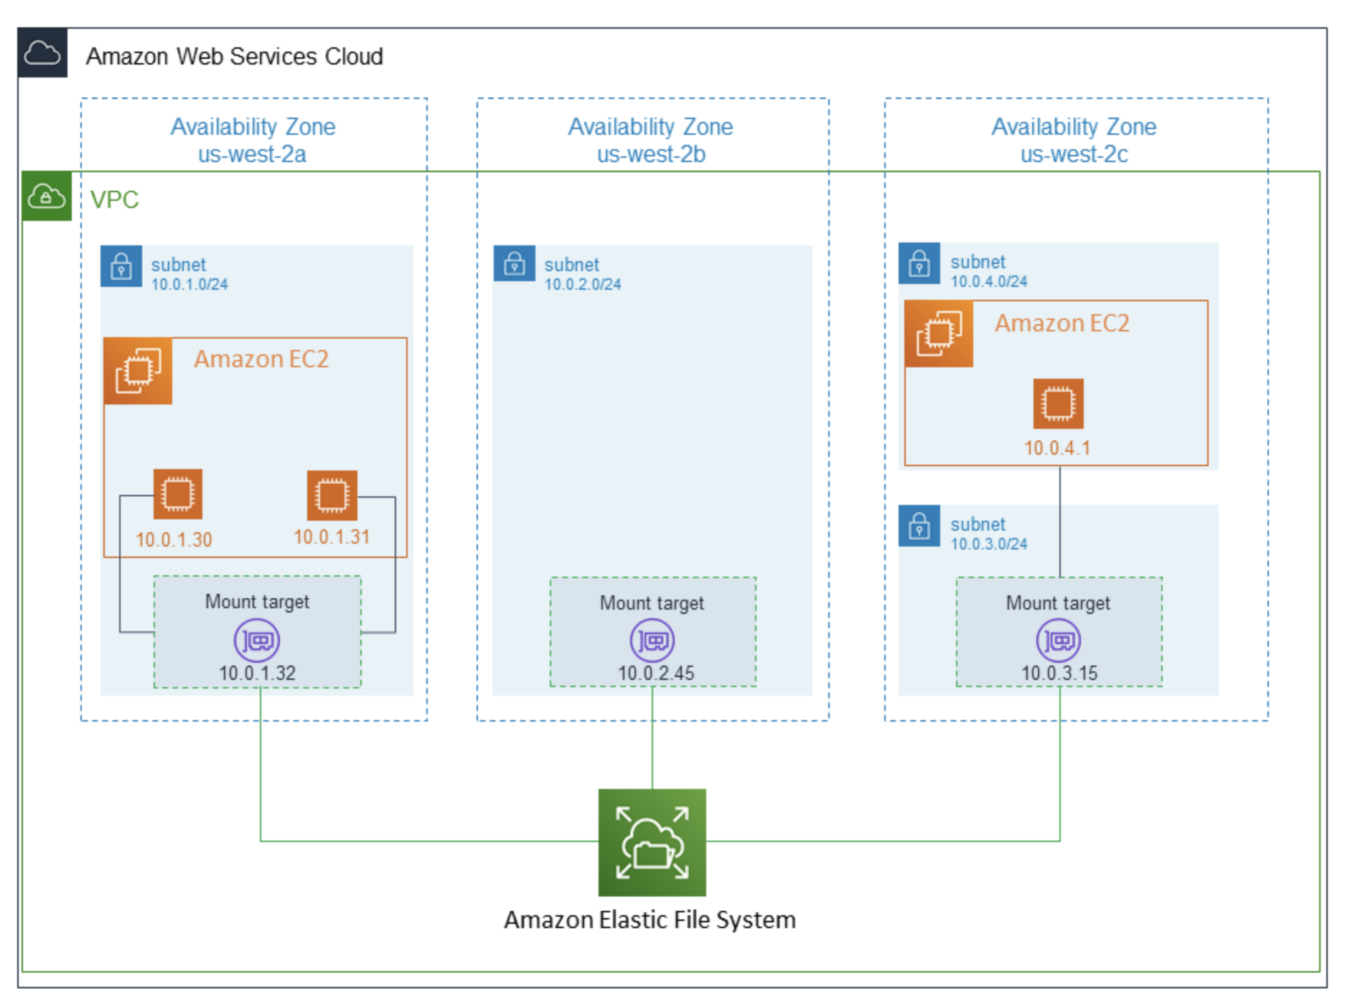
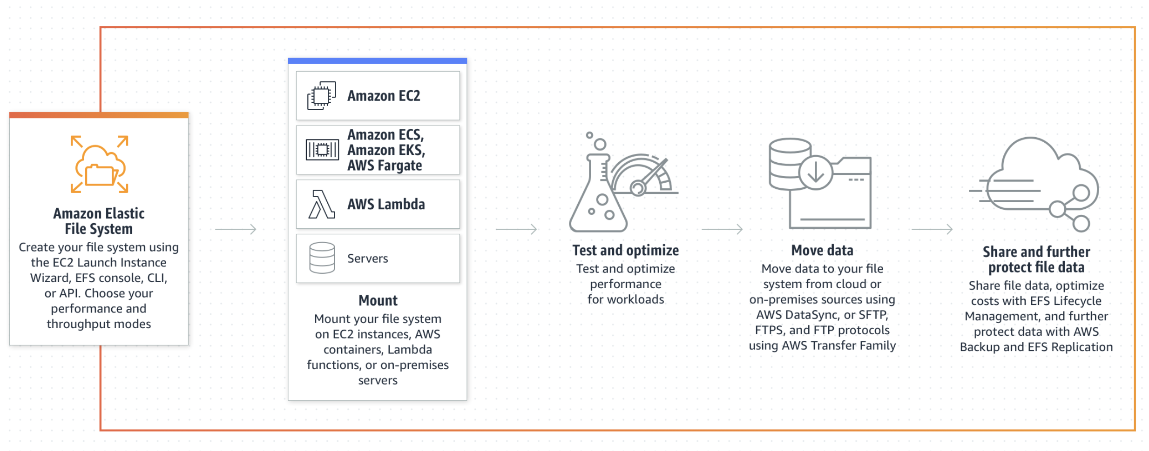
EFS: across availability zone.
You can create a mount target in each Availability Zone in an AWS Region. For EFS file systems that use One Zone storage classes, you can only create a single mount target in the same Availability Zone as the file system. Then you can mount the file system on compute instances, including Amazon EC2, Amazon ECS, and AWS Lambda in your virtual private cloud (VPC).
VPC : Works across the availability zone.
Amazon EFS is a regional service storing data within and across multiple Availability Zones (AZs) for high availability and durability. Amazon EC2 instances can access your file system across AZs, regions, and VPCs, while on-premises servers can access using AWS Direct Connect or AWS VPN.
Amazon Elastic File System (Amazon EFS) automatically grows and shrinks as you add and remove files with no need for management or provisioning.

Slide 17
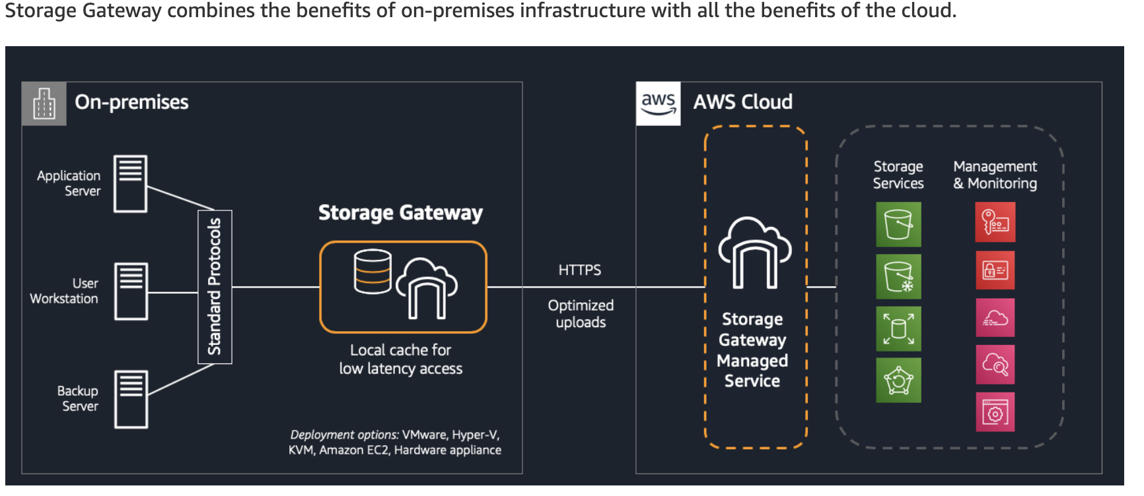
AWS Storage Gateway
Many companies have existing infrastructure in data centers and remote offices but want to take advantage of cloud services. AWS helps these customers accelerate their journey to the cloud by providing hybrid cloud storage services to create a seamless extension of their on-premises infrastructure in AWS. As companies evaluate their applications, some applications are relatively straightforward to move to the cloud, while others are more complex. Applications may need to remain on-premises for performance or compliance reasons, or because they require tight integration with local IT infrastructure. For these reasons, organizations want to explore hybrid cloud storage solutions that provide on-premises access to data stored in AWS.
AWS Storage Gateway is a hybrid cloud storage solution that helps customers overcome these challenges and bridge the gap between their on-premises environments and the cloud. Storage Gateway enables on-premises applications to use cloud storage by providing low-latency data access over standard storage protocols. A local cache stores your most recently used data on-premises, and the cloud provides scalability as well as industry-leading data protection, durability, availability, security, and performance. There are three types of Storage Gateway (File, Volume, Tape)
https://aws.amazon.com/blogs/storage/cloud-storage-in-minutes-with-aws-storage-gateway/

Slide 18
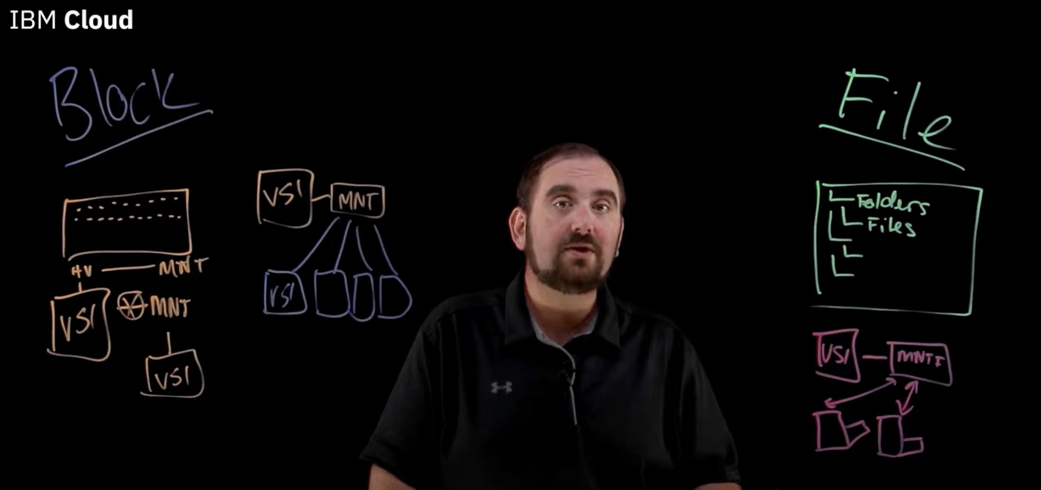
Block Storage
Stored at block level and can be distributed among multiple machines or cluster.
Can be mounted to VM or Hypervisor level also, can be used for booting.
File Storage
Store as file structure (directory structure)
Can not be used for booting the device.
Not recommended for Database storage.
Good for backup and restore.
https://www.ibm.com/cloud/blog/object-vs-file-vs-block-storage

Slide 19
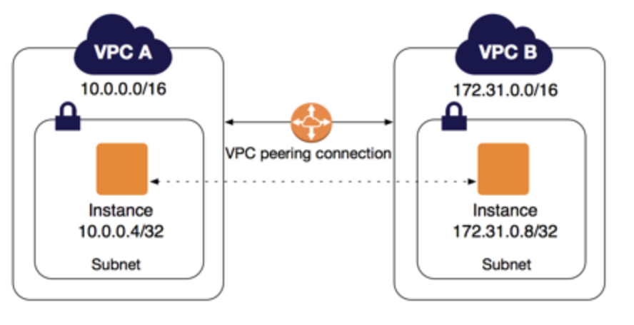
VPC Peering.
A VPC peering connection is a networking connection between two VPCs that enables you to route traffic between them using private IPv4 addresses or IPv6 addresses. Instances in either VPC can communicate with each other as if they are within the same network. You can create a VPC peering connection between your own VPCs, or with a VPC in another AWS account. The VPCs can be in different regions (also known as an inter-region VPC peering connection).
A VPC peering connection helps you to facilitate the transfer of data. For example, if you have more than one AWS account, you can peer the VPCs across those accounts to create a file sharing network. You can also use a VPC peering connection to allow other VPCs to access resources you have in one of your VPCs.
You can establish peering relationships between VPCs across different AWS Regions (also called inter-Region VPC peering). This allows VPC resources including EC2 instances, Amazon RDS databases and Lambda functions that run in different AWS Regions to communicate with each other using private IP addresses, without requiring gateways, VPN connections, or separate network appliances. The traffic remains in the private IP space. All inter-region traffic is encrypted with no single point of failure, or bandwidth bottleneck. Traffic always stays on the global AWS backbone, and never traverses the public internet, which reduces threats, such as common exploits, and DDoS attacks. Inter-Region VPC Peering provides a simple and cost-effective way to share resources between regions or replicate data for geographic redundancy.
AWS uses the existing infrastructure of a VPC to create a VPC peering connection; it is neither a gateway nor a VPN connection, and does not rely on a separate piece of physical hardware.

Slide 20
Amazon CloudWatch
You can use Amazon CloudWatch Logs to monitor, store, and access your log files from Amazon Elastic Compute Cloud (Amazon EC2) instances, AWS CloudTrail, Route 53, and other sources such as on-premises servers.
CloudWatch Logs enables you to centralize the logs from all of your systems, applications, and AWS services that you use, in a single, highly scalable service. You can then easily view them, search them for specific error codes or patterns, filter them based on specific fields, or archive them securely for future analysis.
CloudWatch provides you with data and actionable insights to monitor your applications, respond to system-wide performance changes, and optimize resource utilization. CloudWatch collects monitoring and operational data in the form of logs, metrics, and events. You get a unified view of operational health and gain complete visibility of your AWS resources, applications, and services running on AWS and on-premises. You can use CloudWatch to detect anomalous behavior in your environments, set alarms, visualize logs and metrics side by side, take automated actions, troubleshoot issues, and discover insights to keep your applications running smoothly.
Collect metrics on AWS and on premises
Monitoring your AWS resources and applications is easy with CloudWatch. It natively integrates with more than 70 AWS services, such as Amazon EC2, Amazon DynamoDB, Amazon S3, Amazon ECS, Amazon EKS, and AWS Lambda. It automatically publishes detailed one-minute metrics and custom metrics with up to one-second granularity so you can dive deep into your logs for additional context. You can also use CloudWatch in hybrid environments by using the CloudWatch Agent or API to monitor your on-premises resources.
Improve operational performance and resource optimization
Set alarms and automate actions based on predefined thresholds or on machine learning (ML) algorithms that identify anomalous behavior in your metrics. For example, you can start Amazon EC2 Auto Scaling automatically or stop an instance to reduce billing overages. You can also use CloudWatch Events for serverless to trigger workflows with services like AWS Lambda, Amazon SNS, and AWS CloudFormation.
Derive actionable insights from logs
Explore, analyze, and visualize your logs so you can troubleshoot operational problems with ease. With CloudWatch Logs Insights, you pay only for the queries you run. It scales with your log volume and query complexity, giving you answers in seconds. In addition, you can publish log-based metrics, create alarms, and correlate logs and metrics together in CloudWatch Dashboards for complete operational visibility.
Get operational visibility and insight
To optimize performance and resource utilization, you need a unified operational view, real-time granular data, and historical reference. CloudWatch provides automatic dashboards, data with one-second granularity, and up to 15 months of metrics storage and retention. You can also perform metric math on your data to derive operational and utilization insights; for example, you can aggregate usage across an entire fleet of EC2 instances.

Slide 21
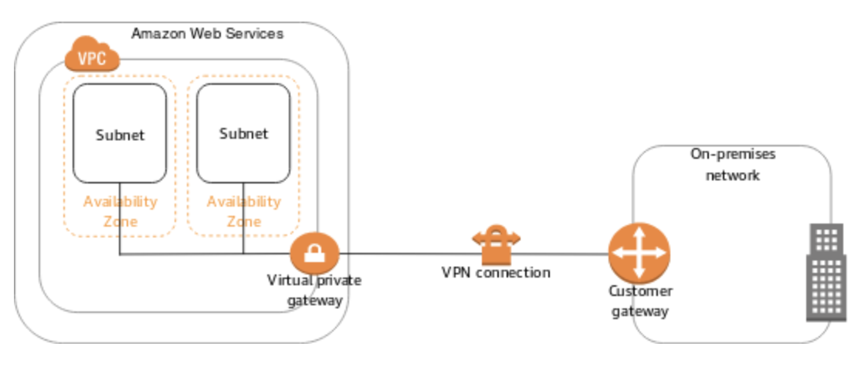
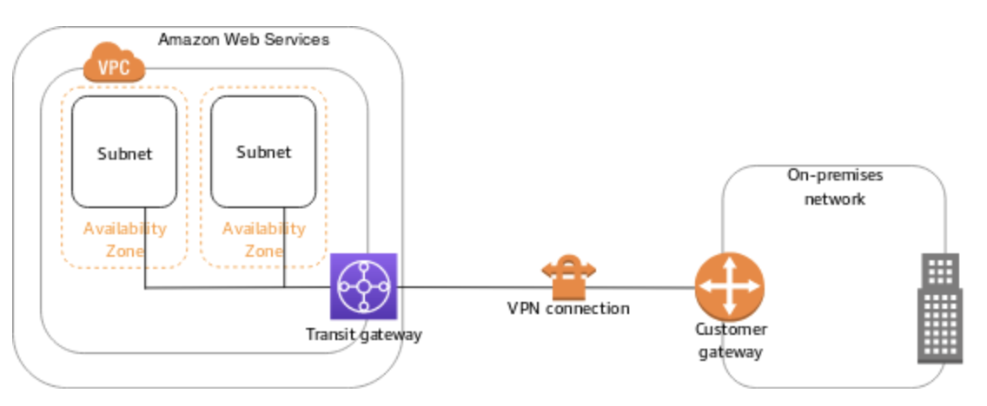
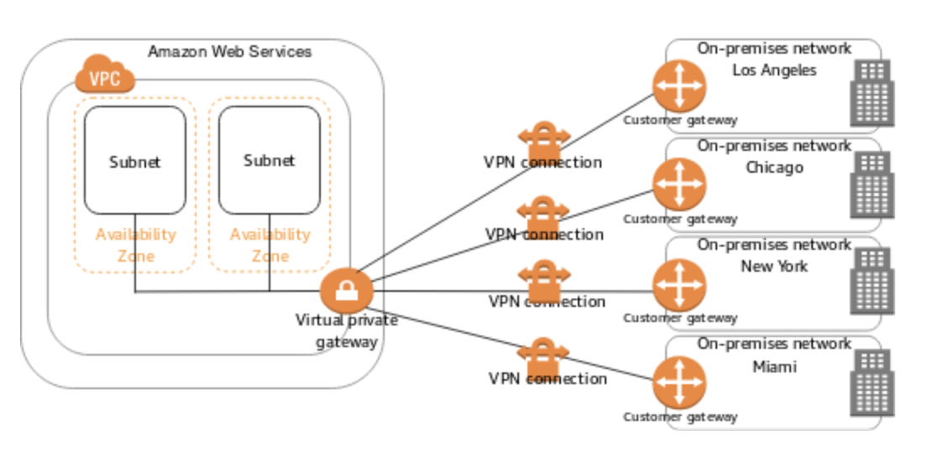
Single Site-to-Site VPN connection
VPN Connection
The VPC has an attached virtual private gateway, and your on-premises (remote) network includes a customer gateway device, which you must configure to enable the Site-to-Site VPN connection. You set up the routing so that any traffic from the VPC bound for your network is routed to the virtual private gateway
The VPC has an attached transit gateway, and your on-premises (remote) network includes a customer gateway device, which you must configure to enable the Site-to-Site VPN connection. You set up the routing so that any traffic from the VPC bound for your network is routed to the transit gateway.
The VPC has an attached virtual private gateway, and you have multiple Site-to-Site VPN connections to multiple on-premises locations. You set up the routing so that any traffic from the VPC bound for your networks is routed to the virtual private gateway.
VPC peering
Functionally, VPC peering is similar to site-to-site VPN, in that it allows communications between two otherwise isolated environments. The biggest difference between VPC peering and site-to-site VPN, however, is that no VPN connection is required.
VPC peering can be used to enable communications between two VPCs that exist within a common AWS subscription. However, VPC peering tends to be more useful for enabling communications between two different AWS accounts. This is useful if you have created separate VPCs for each department and need to enable inter-department communications.
AWS allows you to set up a VPC peering connection between a VPC that is associated with an AWS account, and another VPC that is associated with a different AWS account.
Multiple Site-to-Site VPN connections

Slide 22
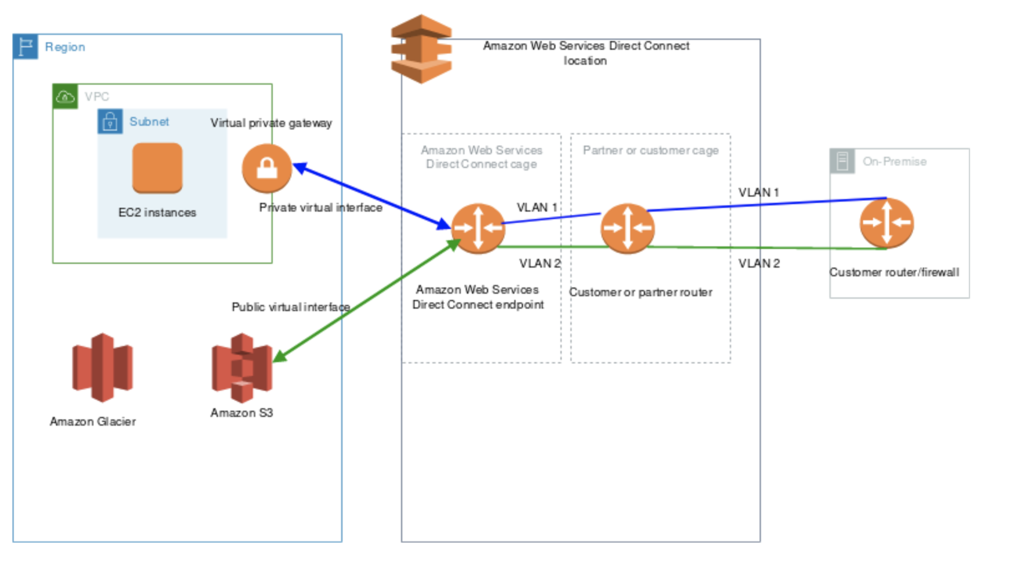
AWS Direct Connect is a networking service that provides an alternative to using the internet to connect to AWS. Using AWS Direct Connect, data that would have previously been transported over the internet is delivered through a private network connection between your facilities and AWS.
AWS Direct Connect can be achieved through the specific locations provided by AWS e.g. GPX, Mumbai.
When requesting a connection, you will be asked to select a AWS Direct Connect location, the number of ports, and the port speed. You work with a Direct Connect Partner for this.
In case your network is not present at an AWS Direct Connect location then WS Direct Connect Partners can help in extending your preexisting data center or office network to a AWS Direct Connect location.
AWS Regions
Direct Connect Location
On Premises

Slide 23
AWS Budgets - gives you the ability to set custom budgets that alert you when your costs or usage exceed (or are forecasted to exceed) your budgeted amount. You can also use AWS Budgets to set reservation utilization or coverage targets and receive alerts when your metrics drop below the threshold you define.
With AWS Budgets, you can choose to be alerted by email or SNS notification when actual or forecasted cost and usage exceed your budget threshold, or when your actual RI and Savings Plans' utilization or coverage drops below your desired threshold.
With AWS Budget Actions, you can also configure specific actions to respond to cost and usage status in your accounts, so that if your cost or usage exceeds or is forecasted to exceed your threshold, actions can be executed automatically or with your approval to reduce unintentional over-spending.
You can create the following types of budgets:
Cost budgets – Plan how much you want to spend on a service.
Usage budgets – Plan how much you want to use one or more services.
RI utilization budgets – Define a utilization threshold and receive alerts when your RI usage falls below that threshold. This lets you see if your RIs are unused or under-utilized.
AWS Budgets now allows you to set RI utilization alerts for your Amazon Redshift, Amazon RDS, and Amazon ElastiCache reservations, in addition to setting alerts on your Amazon EC2 Reserved Instances.
RI coverage budgets – Define a coverage threshold and receive alerts when the number of your instance hours that are covered by RIs fall below that threshold. This lets you see how much of your instance usage is covered by a reservation.
Savings Plans utilization budgets – Define a utilization threshold and receive alerts when the usage of your Savings Plans falls below that threshold. This lets you see if your Savings Plans are unused or under-utilized.
Savings Plans coverage budgets – Define a coverage threshold and receive alerts when your Savings Plans eligible usage that is covered by Savings Plans fall below that threshold. This lets you see how much of your instance usage is covered by Savings Plans.
https://aws.amazon.com/blogs/aws-cloud-financial-management/get-started-with-aws-budgets-actions/?sc_channel=ba&sc_campaign=aws-budgets&sc_medium=manage-and-control&sc_content=web_pdp&sc_detail=mid-banner&sc_outcome=aw&trk=mid-banner_web_pdp_aws-budgets

Slide 24
Global Service.
AWS IAM,
Amazon CloudFront,
Route 53 and
WAF
Amazon S3 is a unique service in the sense that it follows a global namespace but the buckets are regional. You specify an AWS Region when you create your Amazon S3 bucket. This is a regional service.
Q: How is AWS Global Accelerator different from Amazon CloudFront?
A: AWS Global Accelerator and Amazon CloudFront are separate services that use the AWS global network and its edge locations around the world. CloudFront improves performance for both cacheable content (such as images and videos) and dynamic content (such as API acceleration and dynamic site delivery). Global Accelerator improves performance for a wide range of applications over TCP or UDP by proxying packets at the edge to applications running in one or more AWS Regions. Global Accelerator is a good fit for non-HTTP use cases, such as gaming (UDP), IoT (MQTT), or Voice over IP, as well as for HTTP use cases that specifically require static IP addresses or deterministic, fast regional failover. Both services integrate with AWS Shield for DDoS protection.

Slide 25
Reservation models for other AWS services
1. Amazon EC2
2. RDS
3. DynamoDB.
4. Redshift
5. Elastic Cache.
6. Amazon CloudFront
7. Elastic MapReduce.
https://www.botmetric.com/blog/not-only-ec2-6-more-aws-services-can-reserved/
The following AWS services support reservations to optimize costs:
Amazon EC2 Reserved Instances: You can use Amazon EC2 Reserved Instances to reserve capacity and receive a discount on your instance usage compared to running On-Demand instances.
Amazon RDS RIs: Like Amazon EC2 RIs, Amazon RDS RIs can be purchased using No Upfront, Partial Upfront, or All Upfront terms. All Reserved Instance types are available for Aurora, MySQL, MariaDB, PostgreSQL, Oracle, and SQL Server database engines.
Amazon DynamoDB Reserved Capacity: If you can predict your need for Amazon DynamoDB read-and-write throughput, Reserved Capacity offers significant savings over the normal price of DynamoDB provisioned throughput capacity.
Amazon ElastiCache Reserved Nodes: Amazon ElastiCache Reserved Nodes give you the option to make a low, one-time payment for each cache node you want to reserve and, in turn, receive a significant discount on the hourly charge for that node.
Amazon Redshift Reserved Nodes: If you intend to keep an Amazon Redshift cluster running continuously for a prolonged period, you should consider purchasing reserved-node offerings. These offerings provide significant savings over on-demand pricing, but they require you to reserve compute nodes and commit to paying for those nodes for either a 1- or 3-year duration.

Slide 26
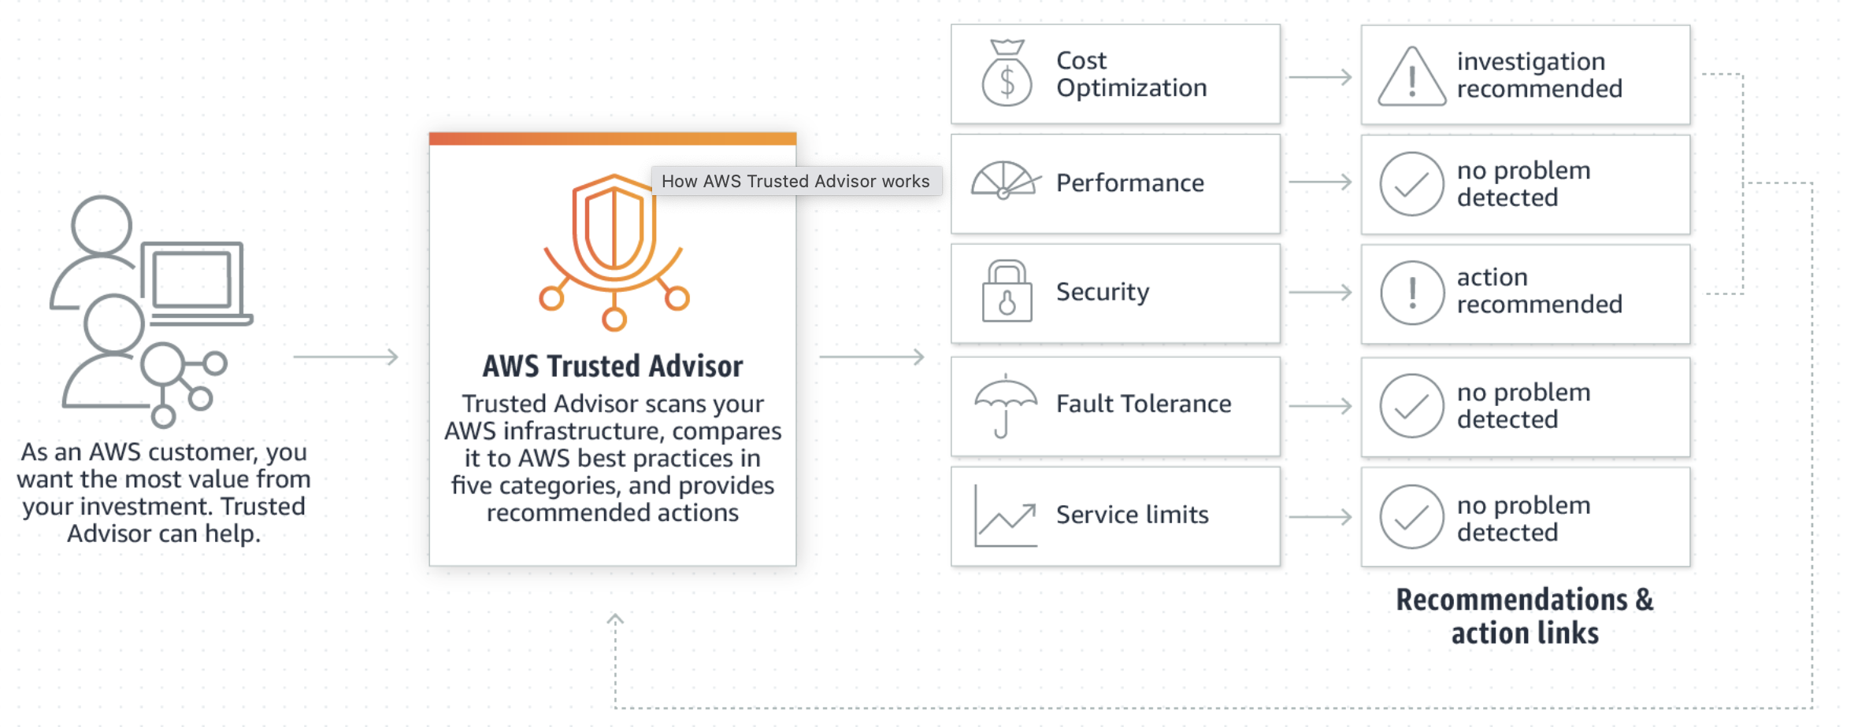
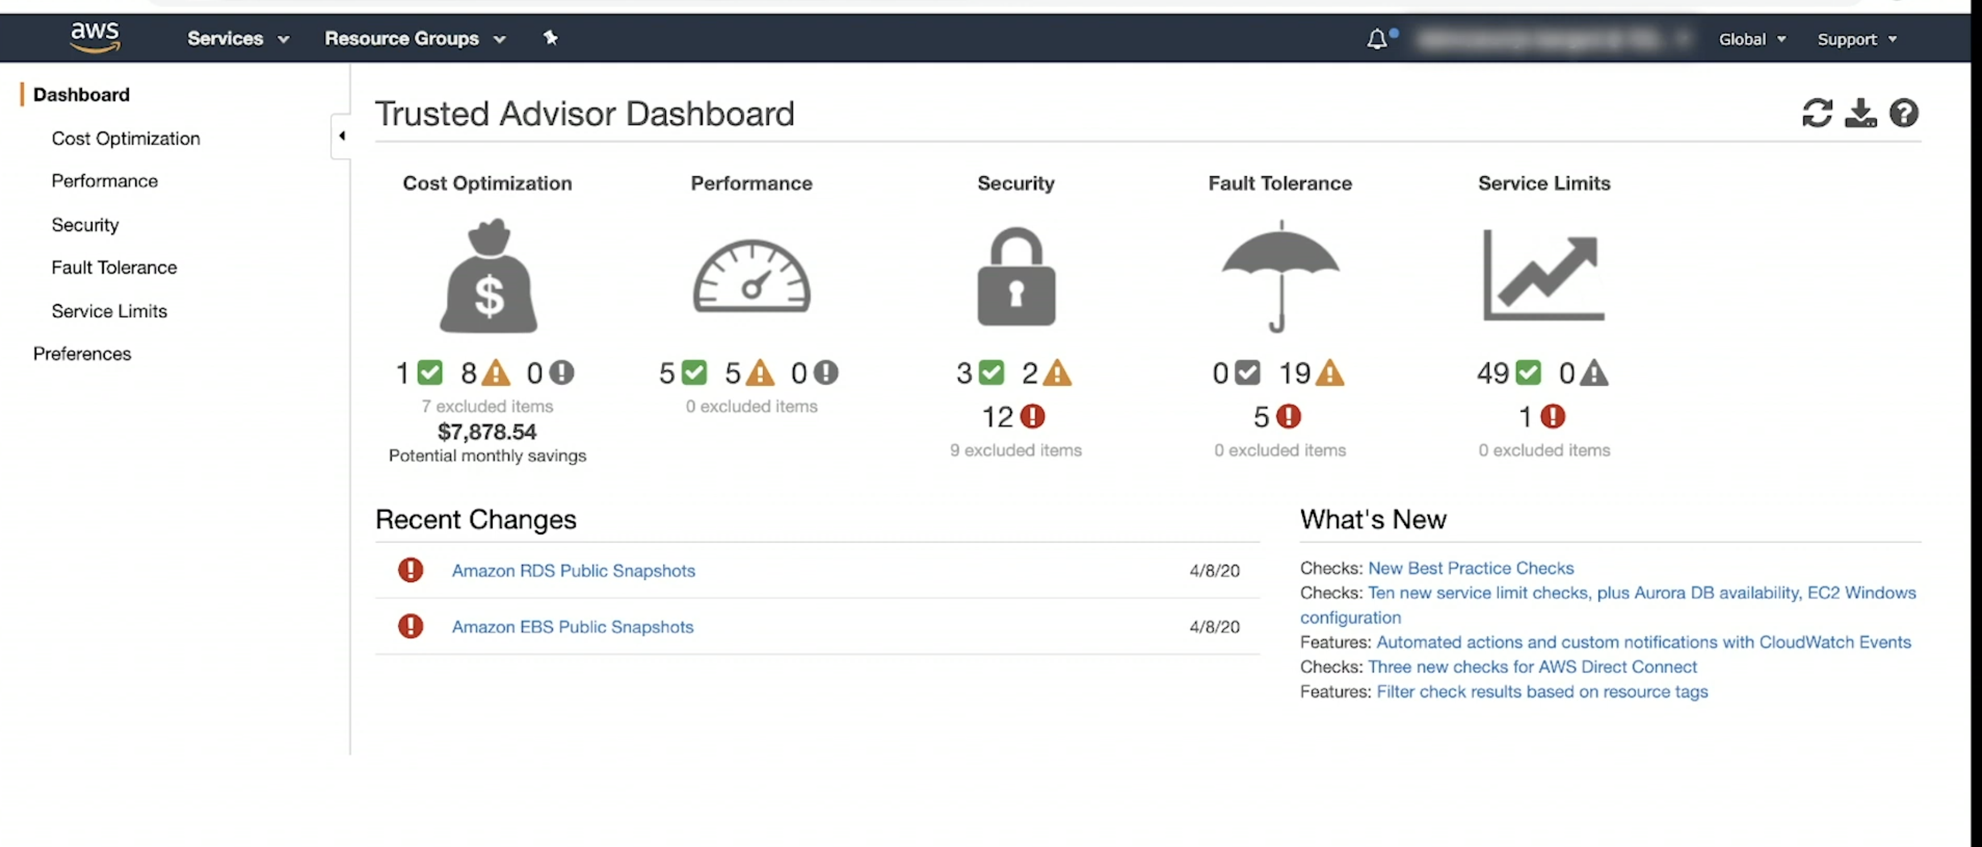
AWS Trusted Advisor - provides recommendations that help you follow AWS best practices.
Trusted Advisor evaluates your account by using checks. These checks identify ways to optimize your AWS infrastructure, improve security and performance, reduce costs, and monitor service quotas. You can then follow the check recommendations to optimize your services and resources.
It inspect your infrastructure in a account across all regions and present aggregated result.
AWS Basic Support and AWS Developer Support customers can access core security checks (6) and all checks for service quotas. Console support only.
AWS Business Support and AWS Enterprise Support customers can access all checks, including cost optimization, security, fault tolerance, performance, and service quotas.
Also have API support and cloud formation support.
https://aws.amazon.com/premiumsupport/technology/trusted-advisor/

Slide 27
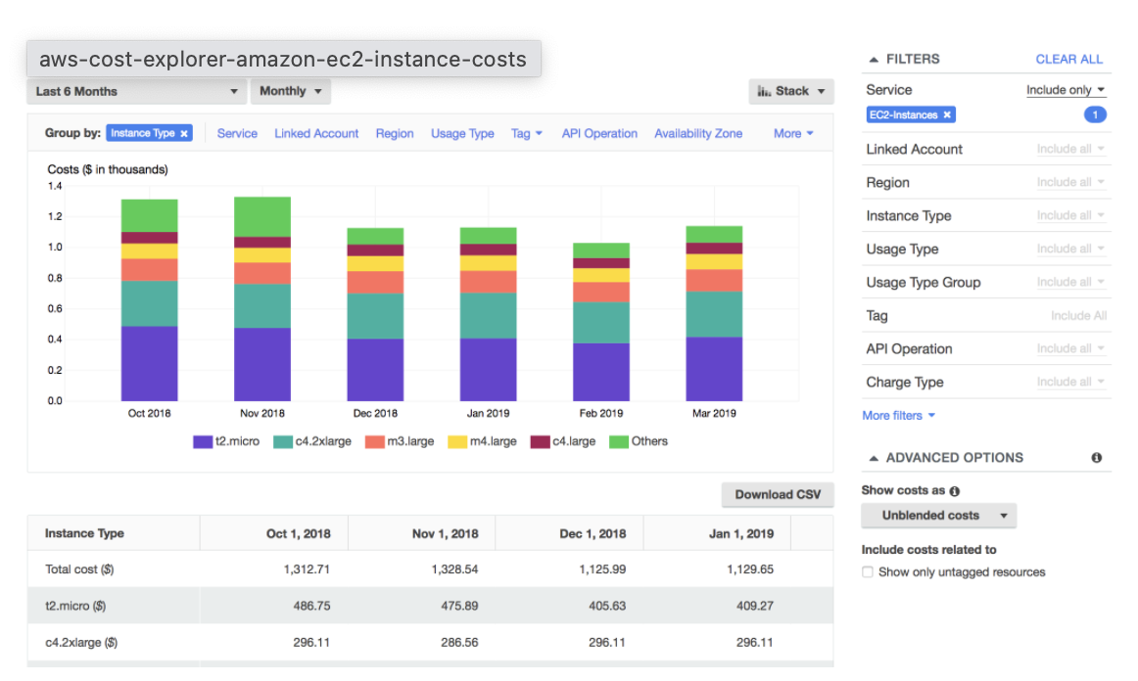
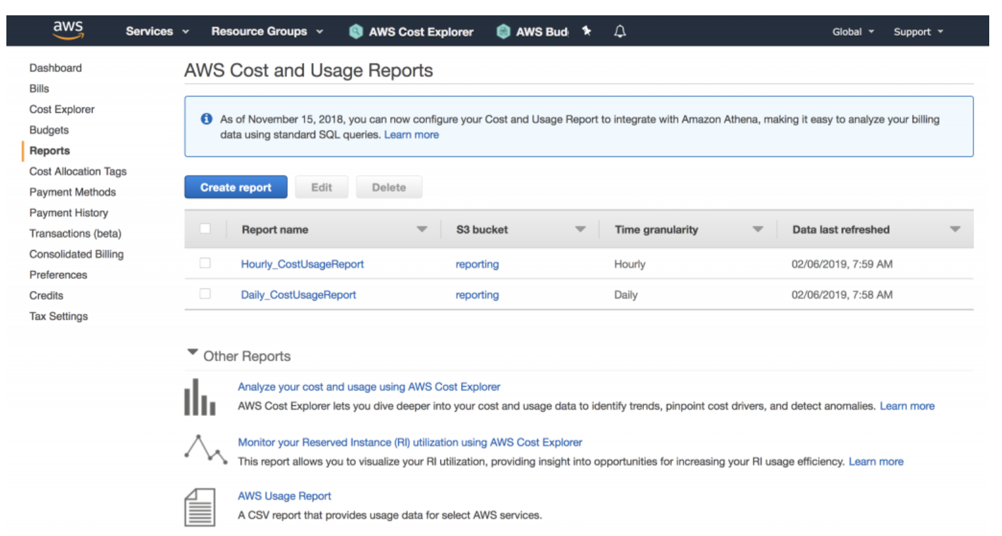
AWS Cost Explorer
includes a default report that helps you visualize the costs and usage associated with your top five cost-accruing AWS services, and gives you a detailed breakdown on all services in the table view. The reports let you adjust the time range to view historical data going back up to twelve months to gain an understanding of your cost trends.
You can also access your data with further granularity by enabling hourly and resource level granularity.
AWS Cost and Usage Reports
The AWS Cost and Usage Reports (AWS CUR) contains the most comprehensive set of cost and usage data available. You can use Cost and Usage Reports to publish your AWS billing reports to an Amazon Simple Storage Service (Amazon S3) bucket that you own. You can receive reports that break down your costs by the hour or month, by product or product resource, or by tags that you define yourself. AWS updates the report in your bucket once a day in comma-separated value (CSV) format.
The AWS Cost & Usage Report contains the most comprehensive set of AWS cost and usage data available, including additional metadata about AWS services, pricing, credit, fees, taxes, discounts, cost categories, Reserved Instances, and Savings Plans.
The AWS Cost & Usage Report is available at an hourly, daily, or monthly level of granularity, as well as at the management or member account level. With the right access, users can access CUR at management and member account level, which saves management account holders from having to generate CUR reports for member accounts.
AWS delivers the AWS Cost & Usage Report to whichever Amazon Simple Storage Service (S3) bucket you specify during setup, and updates the reports at least once per day. You can download the reports using the Amazon S3 console in csv files.

Slide 28
Shared Responsibility Model
AWS responsibility “Security of the Cloud” - AWS is responsible for protecting the infrastructure that runs all of the services offered in the AWS Cloud. This infrastructure is composed of the hardware, software, networking, and facilities that run AWS Cloud services.
Customer responsibility “Security in the Cloud” – Customer responsibility will be determined by the AWS Cloud services that a customer selects. This determines the amount of configuration work the customer must perform as part of their security responsibilities. For example, a service such as Amazon Elastic Compute Cloud (Amazon EC2) is categorized as Infrastructure as a Service (IaaS) and, as such, requires the customer to perform all of the necessary security configuration and management tasks. Customers that deploy an Amazon EC2 instance are responsible for management of the guest operating system (including updates and security patches), any application software or utilities installed by the customer on the instances, and the configuration of the AWS-provided firewall (called a security group) on each instance. For abstracted services, such as Amazon S3 and Amazon DynamoDB, AWS operates the infrastructure layer, the operating system, and platforms, and customers access the endpoints to store and retrieve data. Customers are responsible for managing their data (including encryption options), classifying their assets, and using IAM tools to apply the appropriate permissions.
Inherited Controls – Controls which a customer fully inherits from AWS.
Physical and Environmental controls
Shared Controls –
Controls which apply to both the infrastructure layer and customer layers, but in completely separate contexts or perspectives. In a shared control, AWS provides the requirements for the infrastructure and the customer must provide their own control implementation within their use of AWS services. Examples include:
Patch Management : AWS is responsible for patching and fixing flaws within the infrastructure, but customers are responsible for patching their guest OS and applications.
Configuration Management : AWS maintains the configuration of its infrastructure devices, but a customer is responsible for configuring their own guest operating systems, databases, and applications.
Awareness & Training : AWS trains AWS employees, but a customer must train their own employees.
Customer Specific – Controls which are solely the responsibility of the customer based on the application they are deploying within AWS services. Examples include:
Service and Communications Protection or Zone Security which may require a customer to route or zone data within specific security environments.

Slide 29
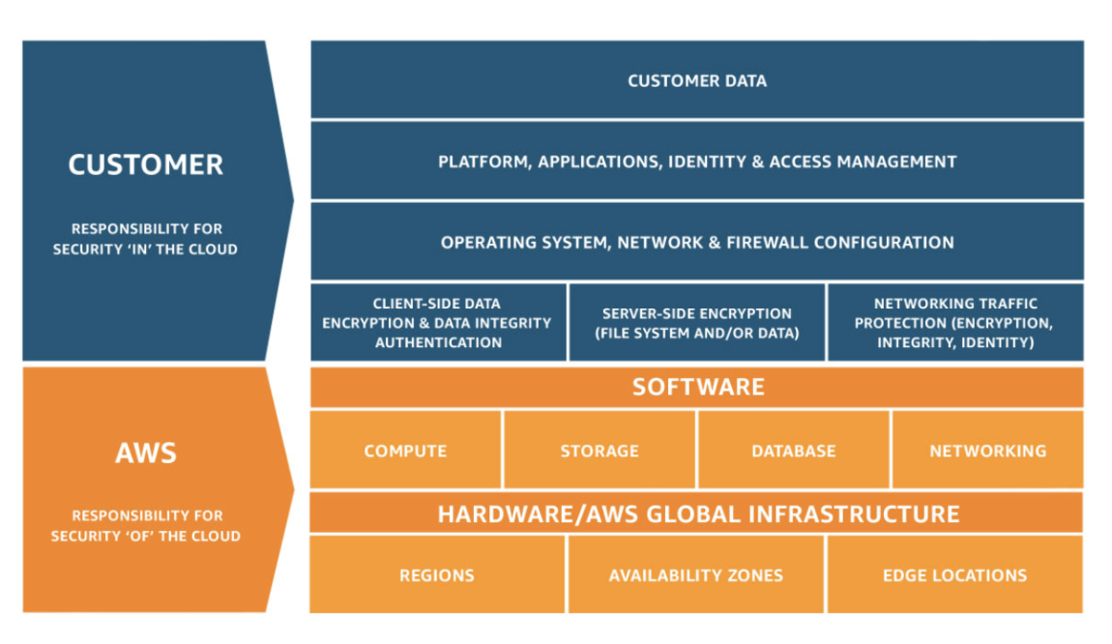
Configuration management
Shared Controls – Controls which apply to both the infrastructure layer and customer layers, but in completely separate contexts or perspectives. In a shared control, AWS provides the requirements for the infrastructure and the customer must provide their own control implementation within their use of AWS services.
Configuration Management – AWS maintains the configuration of its infrastructure devices, but a customer is responsible for configuring their own guest operating systems, databases, and applications.
Operating system (OS) configuration
The customers are responsible for "Security IN the cloud". It includes customer data, as well as the guest operating system configuration.
OS configuration as a whole is a shared responsibility, but be careful: the host OS configuration is the responsibility of AWS, and the guest OS configuration is the responsibility of the customer.

Slide 30
Agility -
Agility refers to the ability of the cloud to give you easy access to a broad range of technologies so that you can innovate faster and build nearly anything that you can imagine. You can quickly spin up resources as you need them – from infrastructure services, such as compute, storage, and databases, to Internet of Things, machine learning, data lakes and analytics, and much more.
AWS Marketplace
is a curated digital catalog that makes it easy for organizations to discover, procure, entitle, provision, and govern third-party software. You can find thousands of software listings from popular categories like security, business applications, and data & analytics, and across specific industries, such as healthcare, financial services, and public sector. You can also explore and buy professional services to configure, deploy, and manage your third-party software. With AWS Marketplace, you can shorten procurement times, implement the controls you need to operate with confidence, and enable your organization to unlock innovation.
Amazon GuardDuty - Is a threat detection service that monitors malicious activity and unauthorized behavior to protect your AWS account. GuardDuty analyzes billions of events across your AWS accounts from AWS CloudTrail, Amazon VPC Flow Logs, and DNS Logs. Its a threat detection service and not a configuration management and tracking service.
AWS Snowball – Is a part of the AWS Snow Family, is a data migration and edge computing device. If you have large quantities of data you need to migrate into AWS, offline data transfer with AWS Snowball can overcome the challenge of limited bandwidth, and avoid the need to lease additional bandwidth. Snowball moves terabytes of data in about a week. You can use it to move things like databases, backups, archives, healthcare records, analytics datasets, IoT sensor data and media content, especially when network conditions prevent realistic timelines for transferring large amounts of data both into and out of AWS.
Amazon Macie -
Amazon Macie is a fully managed data security and data privacy service that uses machine learning and pattern matching to discover and protect your sensitive data in AWS. Macie helps identify and alert you to sensitive data, such as personally identifiable information (PII). This service is an added security feature for data privacy.
AWS Config
AWS Config provides a detailed view of the configuration of AWS resources in your AWS account. This includes how the resources are related to one another and how they were configured in the past so that you can see how the configurations and relationships change over time. AWS Config is designed to help you oversee your application resources in the following scenarios: Resource Administration, Auditing and Compliance, Managing and Troubleshooting Configuration Changes, Security Analysis.
Amazon Redshift
is a fast, fully managed cloud data warehouse that makes it simple and cost-effective to analyze all your data using standard SQL and your existing Business Intelligence (BI) tools. It allows you to run complex analytic queries against terabytes to petabytes of structured data, using sophisticated query optimization, columnar storage on high-performance storage, and massively parallel query execution.

Slide 31
AWS Artifact - is your go-to, central resource for compliance-related information that matters to your organization. It provides on-demand access to AWS’ security and compliance reports and select online agreements.
Reports available in AWS Artifact include our
Service Organization Control (SOC) reports,
Payment Card Industry (PCI) reports, and
certifications from accreditation bodies across geographies and compliance verticals that validate the implementation and operating effectiveness of AWS security controls.
It is not a service, it's a no-cost, self-service portal for on-demand access to AWS compliance reports.
AWS Cost and Usage Reports (AWS CUR) - contains the most comprehensive set of cost and usage data available. You can use Cost and Usage Reports to publish your AWS billing reports to an Amazon Simple Storage Service (Amazon S3) bucket that you own. You can receive reports that break down your costs by the hour or month, by product or product resource, or by tags that you define yourself. AWS updates the report in your bucket once a day in comma-separated value (CSV) format.
AWS Secrets Manager - helps you protect secrets needed to access your applications, services, and IT resources. The service enables you to easily rotate, manage, and retrieve database credentials, API keys, and other secrets throughout their lifecycle. Users and applications retrieve secrets with a call to Secrets Manager APIs, eliminating the need to hardcode sensitive information in plain text.
EC2 Instance Connect
Amazon EC2 Instance Connect provides a simple and secure way to connect to your instances using Secure Shell (SSH). With EC2 Instance Connect, you use AWS Identity and Access Management (IAM) policies and principals to control SSH access to your instances, removing the need to share and manage SSH keys. All connection requests using EC2 Instance Connect are logged to AWS CloudTrail so that you can audit connection requests.
You can use Instance Connect to connect to your Linux instances using a browser-based client, the Amazon EC2 Instance Connect CLI, or the SSH client of your choice. EC2 Instance Connect can be used to connect to an EC2 instance from a Mac OS, Windows or Linux based computer.
Incorrect options:
SSH - SSH can be used from a Mac OS, Windows or Linux based computer, but it's not a browser-based client.
Putty - Putty can be used only from Windows based computers.

Slide 32
AWS WAF is a web application firewall that helps protect your web applications or APIs against common web exploits and bots that may affect availability, compromise security, or consume excessive resources. AWS WAF gives you control over how traffic reaches your applications by enabling you to create security rules that control bot traffic and block common attack patterns, such as SQL injection or cross-site scripting. You can also customize rules that filter out specific traffic patterns. You can get started quickly using Managed Rules for AWS WAF, a pre-configured set of rules managed by AWS or AWS Marketplace Sellers to address issues like the OWASP Top 10 security risks and automated bots that consume excess resources, skew metrics, or can cause downtime. These rules are regularly updated as new issues emerge. AWS WAF includes a full-featured API that you can use to automate the creation, deployment, and maintenance of security rules.
You can deploy AWS WAF on 1) Amazon CloudFront as part of your CDN solution, the 2) Application Load Balancer that fronts your web servers or 3) origin servers running on EC2, 4) Amazon API Gateway for your REST APIs, or 5) AWS AppSync for your GraphQL APIs. With AWS WAF, you pay only for what you use and the pricing is based on how many rules you deploy and how many web requests your application receives.
WAF lets you monitor the HTTP and HTTPS requests to your application, it only works at the application layer (layer 7).
WAF can block all requests except the ones that you specify. This is useful when you want to serve content for a restricted website whose users are readily identifiable by properties in web requests, such as the IP addresses that they use to browse to the website.
By using AWS WAF, you can configure web access control lists (Web ACLs) on your CloudFront distributions or Application Load Balancers to filter and block requests based on request signatures. Besides, by using AWS WAF's rate-based rules, you can automatically block the IP addresses of bad actors when requests matching a rule exceed a threshold that you define. WAF cannot be used to improve the performance of a static website.
Agile protection against web attacks
AWS WAF rule propagation and updates take under a minute, enabling you to quickly update security across your environment when issues arise. WAF supports hundreds of rules that can inspect any part of the web request with minimal latency impact to incoming traffic. AWS WAF protects web applications from attacks by filtering traffic based on rules that you create. For example, you can filter any part of the web request, such as IP addresses, HTTP headers, HTTP body, or URI strings. This allows you to block common attack patterns, such as SQL injection or cross-site scripting.
Easily monitor, block, or rate-limit bots
With AWS WAF Bot Control, you get visibility and control over common and pervasive bot traffic to your applications. Within the AWS WAF console, you can monitor common bots, such as status monitors and search engines, and get detailed, real-time visibility into the category, identity, and other details of bot traffic. You can also block, or rate-limit, traffic from pervasive bots, such as scrapers, scanners, and crawlers. Using AWS Firewall Manager, you can deploy the Bot Control managed rule group across multiple accounts in your AWS Organization.

Slide 33
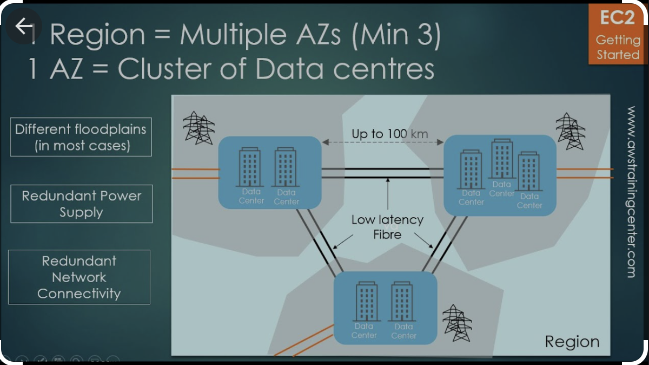
Region & Availability Zone
A Region is a geographical location that hosts one or more Availability Zones in it. A few examples of the currently available Regions that AWS offers publicly are US East, US West, or Asia Pacific. For example, the US East Region may host Availability Zones us-east-1 in Virginia and us-east-2 in Ohio.
The easiest way to remember what this all means is to think of an Availability Zone as its own datacenter, connected to other Availability Zones, all within a portion of the globe that is summarized as a Region. While Regions are designed to be completely isolated from other Regions, Availability Zones are designed to be connected to one another using low latency links in between each Availability Zone in the same Region.

Slide 34
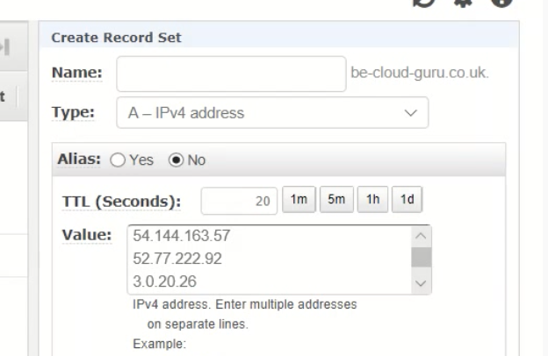
When you create a record, you choose a routing policy, which determines how Amazon Route 53 responds to queries:
Simple routing policy — Use for a single resource that performs a given function for your domain, for example, a web server that serves content for the example.com website.
Weighted routing policy — Use to route traffic to multiple resources in proportions that you specify.
Latency routing policy — Use when you have resources in multiple AWS Regions and you want to route traffic to the region that provides the best latency.
Failover routing policy — Use when you want to configure active-passive failover.
Geolocation routing policy — Use when you want to route traffic based on the location of your users.
Geoproximity routing policy — Use when you want to route traffic based on the location of your resources and, optionally, shift traffic from resources in one location to resources in another.
Multivalue answer routing policy — Use when you want Route 53 to respond to DNS queries with up to eight healthy records selected at random.
Simple routing
Simple routing lets you configure standard DNS records, with no special Route 53 routing such as weighted or latency.
With simple routing, you typically route traffic to a single resource, for example, to a web server for your website.
Single record with multiple values.

Slide 35
Important links
https://aws.amazon.com/premiumsupport/plans/
https://docs.aws.amazon.com/whitepapers/latest/aws-overview/six-advantages-of-cloud-computing.html
https://aws.amazon.com/ec2/pricing/
https://www.youtube.com/watch?v=CMrFIv3a29w
https://aws.amazon.com/compliance/shared-responsibility-model/
https://www.parkmycloud.com/aws-services-list/
https://www.eckher.com/c/21gjdl7gz4
https://intellipaat.com/blog/tutorial/amazon-web-services-aws-tutorial/analytics/
https://aws.amazon.com/s3/storage-classes/

